Slide 1
Declutter Guide
Daniel O’Connor
Daniel@GetWarpIt.com
Warp It Reuse Network

Slide 2
Overview
What is it?
Why is it important?
The approach
Free resources
Communication materials
Action Plan

Slide 3
What is it?

Slide 4
Why is it important?
Keystone habit
Better productivity
Well being

Slide 5
Approach
Intranet guidance for all “wastes”
Bite size actions reduce overwhelm
Passive take up
Monitor
Illustrate benefit
Repeat

Slide 6
Action!
Break down the project
Set short deadlines
Milestones

Slide 7
Milestones
Team: Who can help?
Decide: What materials?
Decide: What disposal routes?
Decide: Comms
Intranet content & support

Slide 8
Issues
No extra work!
Organised and streamlined
More volume in specific time frame

Slide 9
Team
Waste Manager
Space manager
Change manager
Post?
Porters?
Communications

Slide 10
Case study Newcastle University
My Declutter Guide

Slide 11
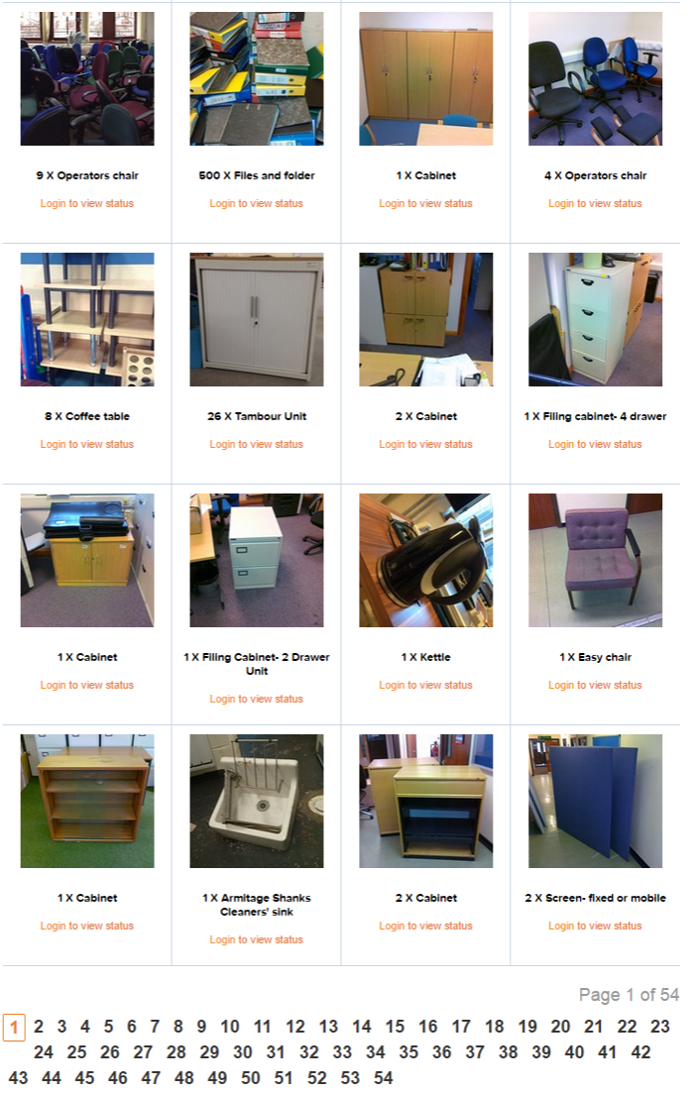
Add to reuse system

Slide 12
Track financial and environmental savings

Slide 13
You made it happen! What next?!

Slide 14
Free Resources
Communication materials
Action plan spreadsheet
Help and advice

Slide 15
Warp It Reuse Network
Daniel O’Connor
Daniel@warp-it.co.uk

Slide 16
Internal Collaboration

Slide 17
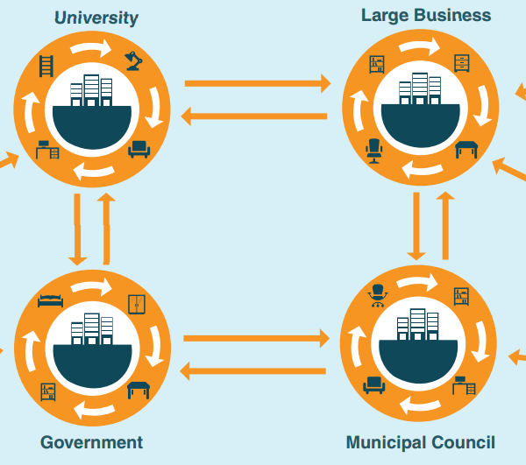
Friend requests

Slide 18
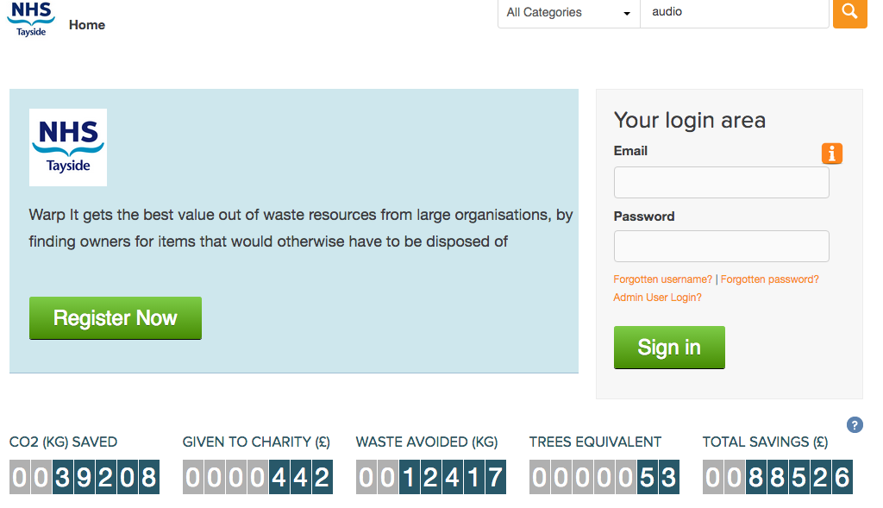

Slide 19
One place on line. Reduces emails Reduces visits Saves time Improves safety Increased participation

Slide 20
System tracks trades. Saves time. Easy Management. Audit trail.

Slide 21
Safety Checks Diverse range of equipment- increase participation. Maximises reuse.

Slide 22
Wishlists Direct transfer- no double handling

Slide 23
Watchlists Plan building moves. Direct transfer.

Slide 24
Win win win

Slide 25
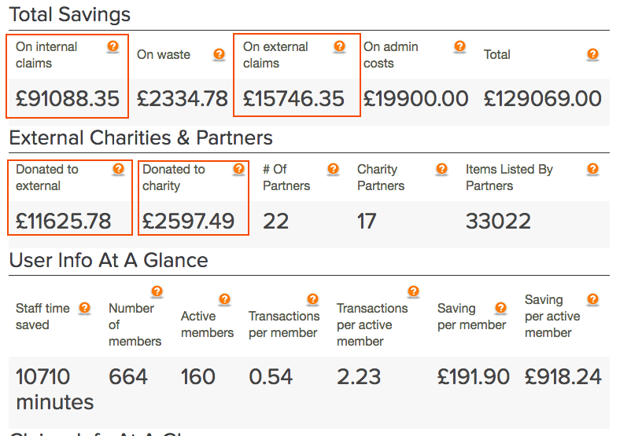
Demonstrate savings. Metrics from NHS Tayside

Slide 26
Declutter Guide
Daniel O’Connor
Daniel@GetWarpIt.com
Warp It Reuse Network

